Slide 1
Magnetic Drilling Machines
& Annular Cutters

Slide 2
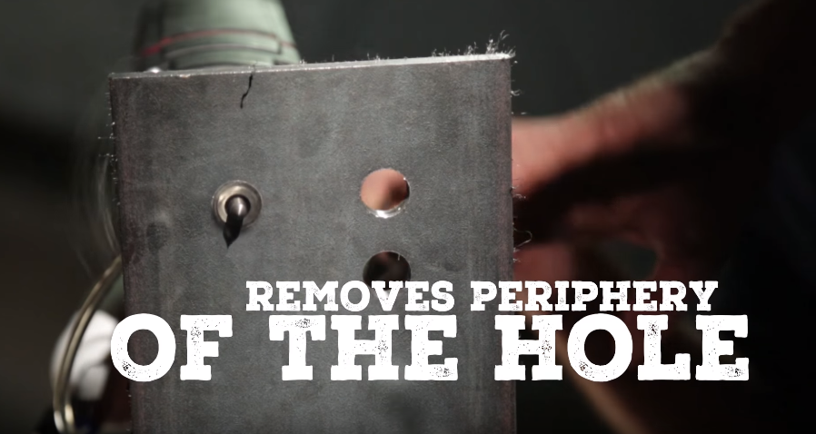
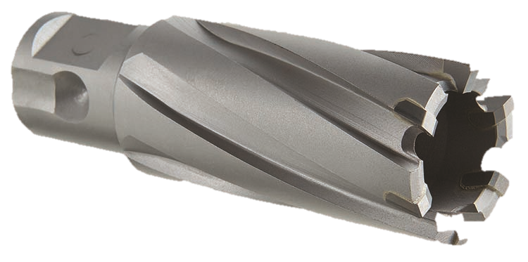
What is an Annular Cutter
A cutting tool used to make a large diameter hole in metal, usually in about 10% of the time of twist drills
Typically used in conjunction with a magnetic drill machine. Increasingly used in CNC operations.
Removes only the periphery of the hole, ejecting a slug at the end of the cut
Sometimes referred to as broach cutters

Slide 3
User Advantages vs. Twist Drills
Less energy
Faster penetration
Less thrust
Less horsepower
Better surface finish
More accurate hole
No secondary operation needed (i.e. reaming)
Longer tool life
Easily re-sharpened
Conventional Twist Drill vs. Annular Cutter
Metal Removal
Conventional Twist Drill
Annular Cutter
1” dia. hole
1” dia. hole
½” Solid Slug
.
.
.
.
.
1” chips
.
.
.
.
.
.
.
.
.
.
½” Chips
.
.
.
.
.
.
.
.
.
.
.
.
.
.
.
.
.
.
.
.
.
.
.
.
.
.
.
.
.
.
.
.
.
.
.
Chips
.
.
.
.
.
.
.
.
.
.
.
.
.
.
.
.
.
.
.
.
.
.
.
.
.
.
.
.
.
.
.
.
.
.
.
.
.
.
.
.
.
.
.
.
.
.
.
.
.
.
.
.
.
.
.
.
Solid Slug
.
.
.
.
.
.
.

Slide 4
Drillco Annular Cutters Program
High Speed Steel
1” DOC – 9100SE*
2” DOC – 9200SE*
3” DOC – 9300SE
4” DOC – 9400SE
Sizes ranging from 7/16” – 4”
Nitro Cobalt
1” DOC – 9100N
2” DOC – 9200N
3” DOC – 9300N
Sizes ranging from 7/16” – 2.1/4”
Carbide Tipped
1.3/8” DOC – 9100CT
2” DOC – 9200CT
Accessories
1/2” and 3/4” Shank Adapters
Morse Taper Shank Adapters
Ejector Pins
Sets
7pc Sets in HSS or Cobalt
32pc Fractional Sizes Display
*Available pre-packaged with corresponding ejector pin

Slide 5
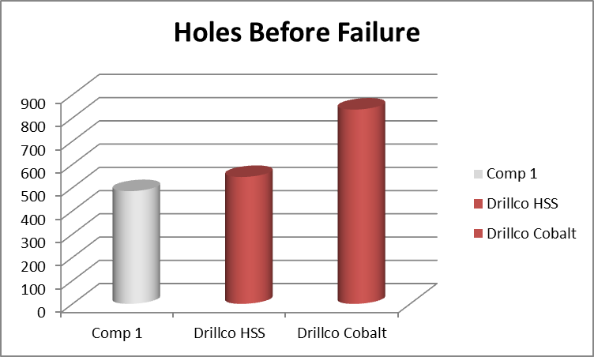
Recognized Brand Competitive Test
Drillco HSS cutter lasted longer than nationally recognized competitor HSS Cutter
Drillco Cobalt (Nitro) cutter lasted nearly 2x as long as nationally recognized competitor HSS cutter

Slide 6
Carbide Tipped Annular Cutters
Makes a hole in less time when compared to regular HSS cutters
Delivers reamed quality, burr free holes
Universal shank fits most magnetic drilling machines including those with tool less arbors and set-screw arbors
Available in 1.3/8” and 2” depths of cut, with diameters up to 2.3/8”

Slide 7
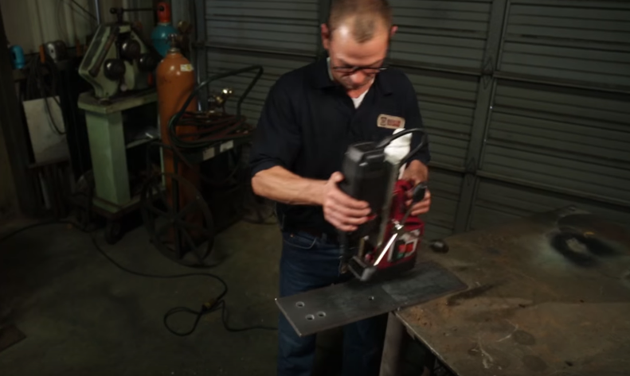
What is a Magnetic Drilling Machine?
Portable machines used to drill holes on remote job sites
Typically used in conjunction with an annular cutter or twist drill
Used in a wide variety of industries including construction and manufacturing
Can either be electric, pneumatic, or hydraulic powered
Feature a magnetic base that holds to the workpiece

Slide 8
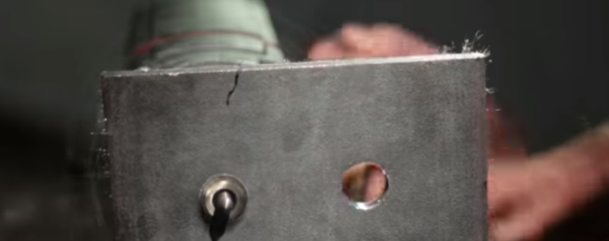
Where are they used?
Job sites were portability is important
By machinists, fabricators, contractors and more
In hard-to-reach or confined spaces
To cut holes in pipes/tubes in the oil & gas industry where twist drills often fail
To cut holes in structural plates

Slide 9
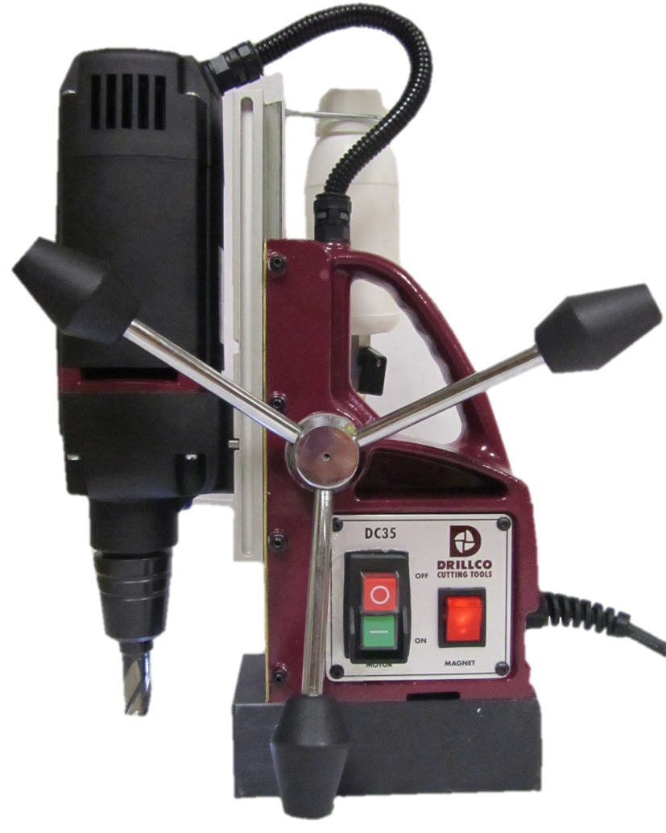
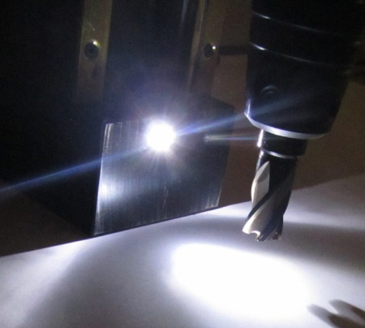
DC35
One of the most powerful mag base machines for its size
Overload protection
Extremely compact and lightweight, which makes it easy to maneuver and ideal for the work site
Mag drill arbor is easily replaced with 1/2” chuck for twist drills
Adjustable reach for twist drills and for drilling deeper holes
LED light in the base of the machine lights the pilot point. Beneficial when drilling in low light areas!

Slide 10
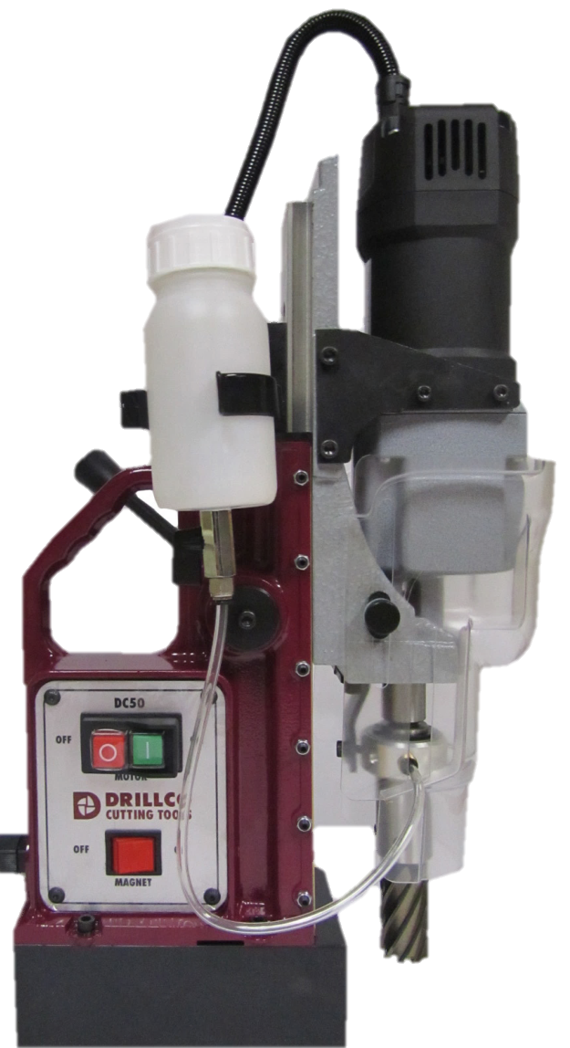
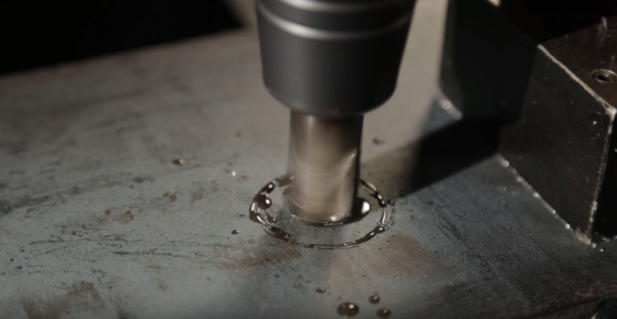
DC50
Variable speed control with 2 gear ranges
Powerful new light weight motor unit
Integral arbor for precise cuts
Stroke is the longest in it’s class
Quick conversion to twist drills
Overload protection
Integrated automatic lubrication system

Slide 11
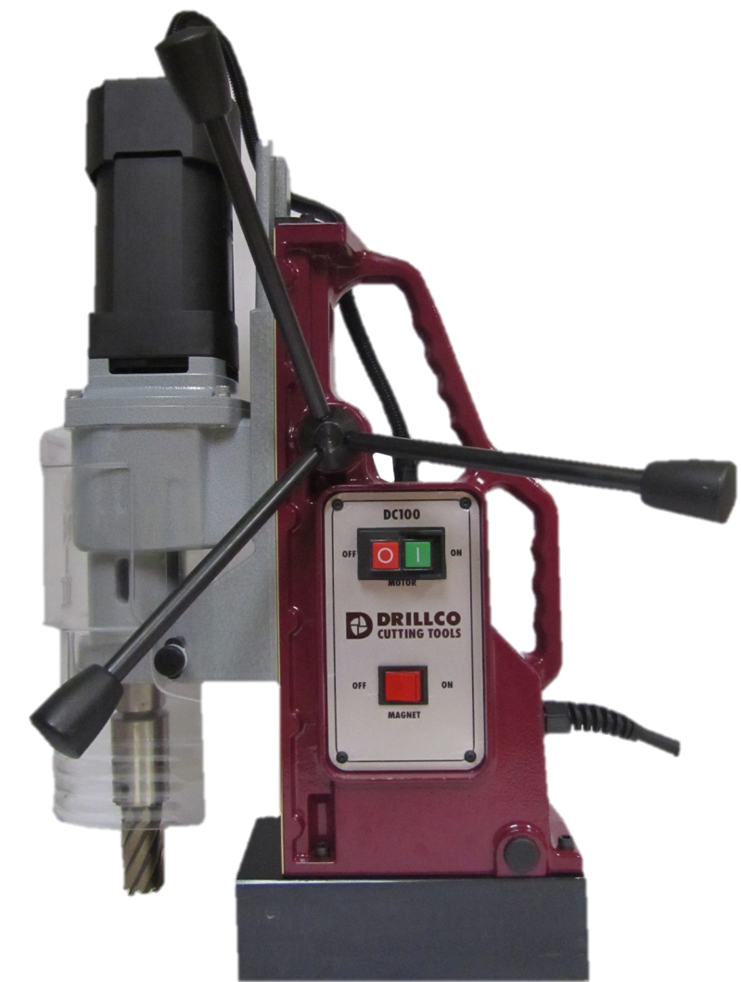
DC100
Variable speed control with 2 gear ranges, and 5 speeds
Stroke is longer than competitors
Integral arbor for precise cuts
Torque overload protection sensor
Automatic integrated lubrication system
Up to 4” Cutter capacity, and 1.1/2” Twist Drill Capacity

Slide 12
Re-sharpening Program
Get the most out of your investment by re-sharpening your cutter at a fraction of the original cost
Annular cutters can be resharpened up to 3 times
No set-up or minimum quantity charges
Tools are resharpened at our own state of the art facility, ensuring consistent quality and enabling an extremely quick turnaround time upon receipt
Re-sharpening available on our entire offering
Competitively priced, with quality guaranteed
Call today to take advantage of this exceptional service from Drillco!

Slide 13
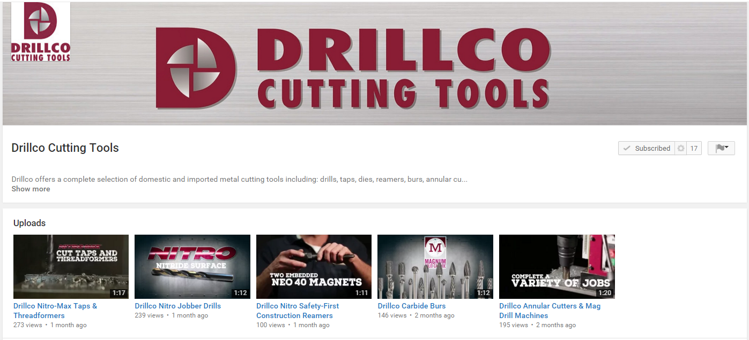
Product Videos
Drillco YouTube channel >
Demonstrates key features, benefits, and uses of our core products
Annular Cutters & Magnetic Drill Machines
Check out our new Annular Cutters and Magnetic Drills Product Brochure!

Slide 14
Tips for Successful Cutting
Always make sure that the slug ejects at the end of the cut before starting a new hole
Clear away any chips left behind before starting a new hole
Ensure that the set screws used to hold the cutter are tight. This will improve hole quality and ensure better tool life.
Use a pilot pin. This will help you eject the slug at the end of the cut, and will aid in getting the coolant to flow to the cutting teeth.
Ensure that the on-board integrated lubrication system has plenty of fluid. This will help to dissipate the heat generated when cutting the hole.
For angled holes, make sure the centerline is no more than 20° from perpendicular. Reduce feed rates until the cutter is fully engaged. Use a brass or other soft metal bushing.
Select the right cutter for the job. For harder materials, make sure to use a Cobalt or Carbide Tipped cutter. Also make sure that you have enough reach with the cutter and machine to drill through your workpiece.
When cutting stainless steel, the magnet will not stick. You must clamp a ferrous metal to the surface for the magnet to rest on.
Use aggressive feed rates on stainless steel and other hard to drill materials
Always wear safety glasses and use the provided safety shield while operating
For more tips on using magnetic drilling machines and annular cutters, please see our “Guide to Good Drilling” manual included with each machine from Drillco!

