Slide 1
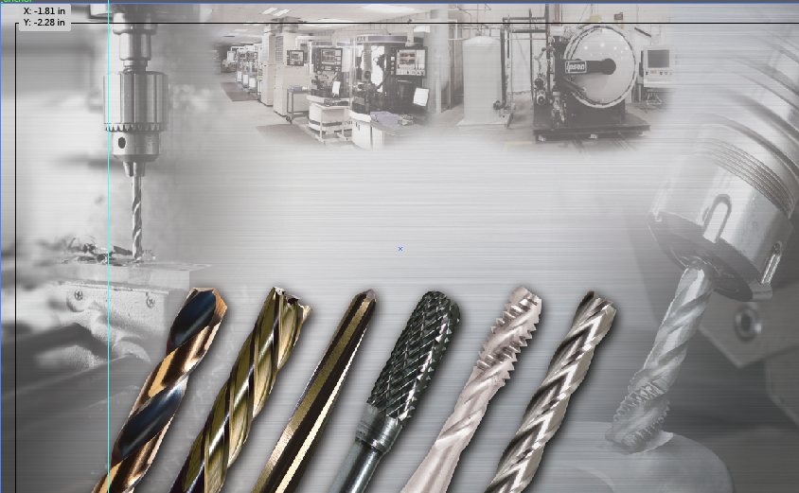

Module 1
DRILLING

Slide 2
8 REQUIREMENTS FOR SUCCESSFUL DRILLING
Handling
Machine
Chucking System
Coolant
Work Material
Cutting Conditions
Work Piece Clamping
Drill Condition

Slide 3
BASIC DRILL NOMENCLATURE
Overall
Length
Body
Shank
Length
Flute
Length
Web at Point
Shank
Web at Back
Land
Margin
Axis
Shank Diameter
Neck
Flutes
Point
Angle
Lead
Diameter
KEY Items
Notes:
All drills have features that contribute to their overall construction. These features are known as Nomenclature. A drill must contain certain features in order to perform effectively in various applications and materials.
Standard twist drills are manufactured in a wide variety of types, and in many different sizes. To produce a hole of any given diameter, twist drills are commercially available with variations in diameter, overall length, flute length, point geometry, web styles and thickness as well as various shank configurations. These can also be known as Envelope Dimensions.
Drills are manufactured in many different diameter sizes;
Fractional
Number (Wire gage)
Letter
Metric
Usually ranging from .0059 to 3-1/2” diameters

Slide 4
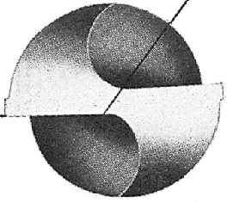
BASIC DRILL NOMENCLATURE
Chisel Edge
Chisel
Edge Angle
Lip
Lip
Notes:
Now looking at the business end of the drill we see the Cutting Edges or the preferred term is Lips. The Lips are the cutting edges of a two flute drill extending from the chisel edge to the periphery. They are connected by the chisel edge.
The Chisel Edge is the end of the web that connects the Lips. It wedges material and directs it towards the cutting edges. It is set at an angle referred to as the Chisel Edge Angle.
The Chisel Edge Angle is the angle included between the chisel edge and the cutting lip, as viewed from the end of the drill.

Slide 5
FLUTES
Flute
Allows:
removal of chips
    flow of cutting fluid
Notes:
Also contained in the body of the drill are the flutes. The Flutes are helical or straight grooves cut or formed in the body of the drill to provide cutting lips, to permit removal of chips and to allow cutting fluid to reach the cutting lips. There can be any number of flutes depending on the type of tool being utilized.

Slide 6
FLUTE ANGLES
Slow Spiral
18°- 22°
Medium (Gen Purpose)
28°- 32°
Fast Spiral
36°- 40°
Notes:
Slow Spiral drills generally in the range of 18° to 22° are designed primarily for drilling shallow holes in Brass, Aluminum, Magnesium, Hard Rubber, Wood and Plastic. The flute construction of this type of drill will readily remove the large volume of chips formed by high rates of penetration.
Medium Spiral drills generally in the range of 28° to 32° are designed to perform satisfactorily in a wide variety of Irons and Steels under as many different conditions as possible. This drill may be considered a high production tool for all jobs except those where some element of material or set-up presents a particularly difficult problem.
Fast Spiral drills generally in the range of 36° to 40° have been developed especially for drilling deep holes in materials of low tensile strength, such as Aluminum, Magnesium, Copper, Wood and some types of plastics. Occasionally it can be used for soft or leaded steels, free machining brasses and bronzes as well as some free machining stainless steels.

Slide 7
SHANKS
Common Shank Styles in General Purpose Drilling
Straight Shank
Straight Shank w/Flats
Reduced Shank
Reduced Shank w/Flats
Taper Shank
Notes:
There are many standard shank variations, all designed to adapt to the what is driving the tool
Straight Shanks
Straight Shanks w/Flats
Reduced Shanks
Reduced Shanks w/Flats
Taper Shanks contain variations such as;
1.) Tapers Larger than Standard
2.) Tapers Smaller than standard
3.) Coolant Feeding (with side or end entry)
It should be noted that taper shank drills contain tangs for the purpose of removal of the drill from a spindle and should not be used for the purpose of driving the drill.

Slide 8
OVERALL LENGTH
Common Drill Lengths
Stub Length
Mechanic Length
Jobber Length
Taper Length
Extra Length (8”/12”/18”)
Aircraft Extension Length (6”/12”)
Notes:
The longer the drill, the more resulting deflection is created. (Ruler overhanging edge of table is a good visual for length/deflection)
The shallower the hole, the shorter drill length is required.
Most common general purpose drill used is a “jobber length”
In own words describe where each length is best suited

Slide 9
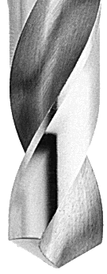
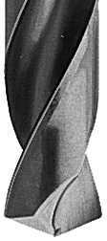
POINT ANGLES
Common Drill Point Angles
118°
135°
Used for mild steels and free machining materials
Used for tough to machine and high alloy materials
Notes:
Smaller included point angles (118°) used in mild steels and cast irons distribute the cutting load over a longer length of lip thus reducing load. This reduced loading enables the lips to better reduce wear. Plus directs the flow of chips into the flute bottom.
Larger included point angles (135°) are helpful with hard - to - drill materials because the chips produced are thicker. Most materials can be more effectively cut in the form of thick chips. The thicker chip also tends to reduce the amount of work hardening of most materials. Torque requirements are also reduced due to shorter length of lip.

Slide 10
POINT ANGLES
118° Conventional Point
General purpose
Main Advantage
Widely available
Least expensive
Acceptable drill life
Best suited where high precision or production is not required
Main Disadvantage
Corner breakdown
Drill tends to “walk” (may need spot drill)
May produce burr on breakthrough
Notes:
The conventional point is the most commonly used drill point. Properly produced, it will give satisfactory drilling results in a wide variety of materials. In use it may require some form of web thinning when used on drills whose web thickness has increased because of repeated resharpening, or on drills of heavier web construction.

Slide 11
POINT ANGLES
118° or 135° Split Point
Modified conventional point
Main Advantage
Widely available as standard
Self-centering therefore less “walking”
Great on curved surfaces and in “hand drilling” applications
Improved penetration rates, requires less thrust, breaks up chips
Main Disadvantage
Most difficult point to regrind correctly!
Decreased cutting lip “strength”
Not available under 1/16 diameter as a standard
Notes:
This type of point (split) was originally developed for use on drills designed for drilling deep oil holes in automotive crankshafts. Today it is used on many designs of drills used in a wide variety of hard and soft materials. It can be applied to a variety of drill point angles, the most common being 135°. The main advantage to this type of point is the web thinning which greatly reduces thrust and adds a positive rake cutting edge that extends to the center of the drill. In many materials this point will act as a chip breaker to produce small chips which can be ejected through the flutes. The split point minimizes skidding or walking of the drill point when starting a hole. This is a distinct advantage when portable drilling or in a drill press where bushings cannot be used.

Slide 12
COMMON DRILL MATERIAL (SUBSTRATES)
HSS (High Speed Steel)
HSCo (Cobalt High Speed Steel)
SC (Solid Carbide)
Notes:
HSS (High Speed Steel) is the most commonly used tool material for general purpose drilling. The composition of HSS allows for an ideal blend of “toughness” and “wear resistance” suitable for most materials, including low to medium strength steels, stainless steels, aluminum and other non-ferrous materials.
HSCo (Cobalt High Speed Steel) composition allows for an elevated tool “hardness”. This increased hardness provides improved “wear resistance” suitable for higher strength steels and tough to machine materials. Caution should be observed when using HSCo tooling as the increased hardness creates a more “brittle” tool.
SC (Solid Carbide) is best suited for very hard and very tough to machine materials. This type of tool is very brittle and should be used in stationary equipment rather than portable hand-held devices.

Slide 13
MATERIAL HARDNESS & TOUGHNESS
Wear-
resistance
(Hardness)
Diamond
Cubic boron nitride
Ceramics
Solid carbide
High-speed-steel
Toughness

Slide 14
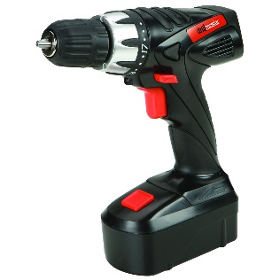
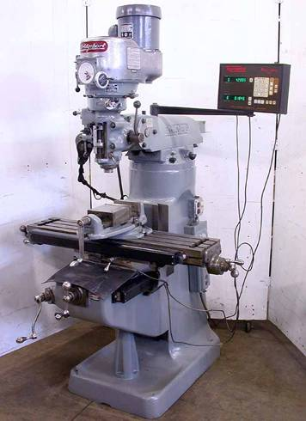
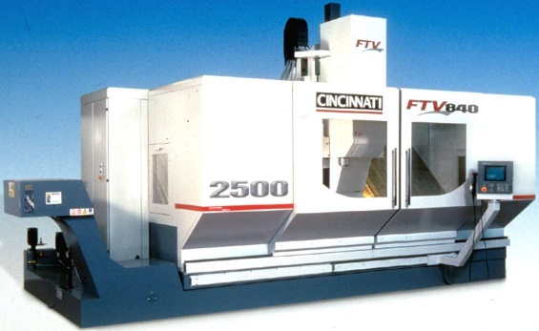
COMMON DRILLING METHODS
Hand-held
Conventional
CNC

Slide 15
DRILL MOVEMENTS
Feed =
IPR or IPM
Rotation =
RPM or SFM
IPR = Inches Per Revolution ; IPM = Inches Per Minute
RPM = Revolutions Per Minute ; SFM = Surface Feet per Minute

Slide 16
CUTTING CONDITIONS
Speed (Vc), Feed (f), and Depth of Cut (DOC)
  Speed/RPM has the greatest influence in performance!
  Speed creates HEAT – HEAT KILLS CARBIDE!
  Too slow also creates too much heat.
Feed is the second factor
  Feed rate influences chip control.
    Too slow, chips pack; too fast, drill walks or spindle loads up
DOC has the least influence
  Drills are made to remove material.

Slide 17
CUTTING CONDITIONS
Remember this:
  50% increase in speed = 50% decrease in tool life
  50% increase in feed = 20% decrease in tool life
  50% increase in DOC = very little change
    Less holes, but linear inches should stay same

Slide 18
DRILLING FORMULAS
TERMS
IPM = Inches per Minute
IPR = Inches per Revolution
RPM = Revolutions per Minute
SFM = Surface Feed per Minute
D = Drill Diameter
FORMULA
SFM = D x RPM x .262
RPM = SFM x 3.82
D
IPM = IPR x RPM
IPR = IPM
RPM

Slide 19
TERMINOLOGY
DRILL - To machine a hole in a work piece. Drilling differs from boring in that boring starts with an existing hole and enlarges it.
DRILL PRESS - A small, very common machine tool in which vertical movement of the spindle head is controlled by a manual rotation of the pressure feed.
BLIND HOLE - A hole that does not go completely through an object.
BURR - A thin edge of metal, usually very sharp, left from a machining operation at the point the tool exits the work piece.

Slide 20
TERMINOLOGY
CUTTING FLUID - A term referring to any of several liquids used to decrease temperature or increase lubricity when cutting metal. Examples include cutting oils, soluble or emulsified oils (water based), and sulfurized oils.
COLLET - A small, precision, self-centering machine chuck. Also called Collet Chuck.
FLUTE - Grooves cut into the bodies of high speed steel milling cutters, drills and reamers.
HELIX - The path described by a point rotating about a cylinder while at the same time being moved along the cylinder. Examples of a helix include a drill flute, a thread or a spring.

Slide 21
TERMINOLOGY
REAMER - Precision tool used to bring existing holes to a more exact size and improve the surface finish by machining a small amount of material from the inside diameter surface of the hole. Properly reamed holes remove no more than .015" of stock and should be within .001" of nominal size.
TORQUE - A force that acts to produce rotation.

