Slide 1
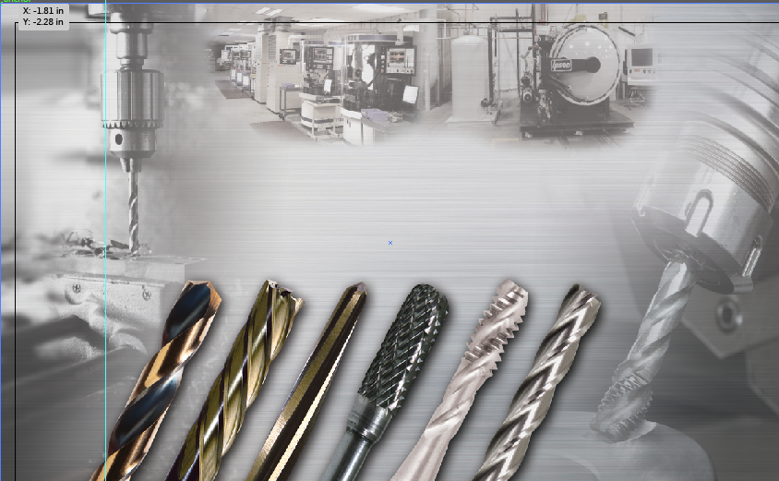
Module 1
TAPPING

Slide 2
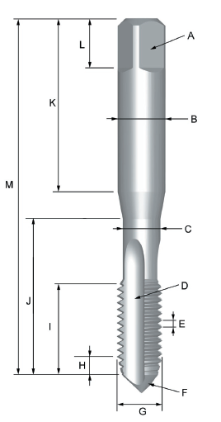
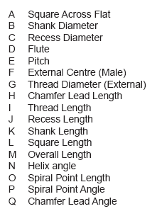
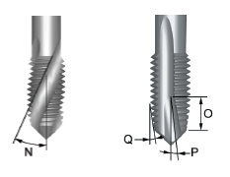
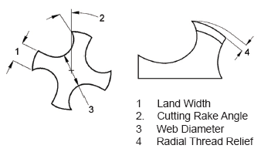
TAP NOMENCLATURE

Slide 3
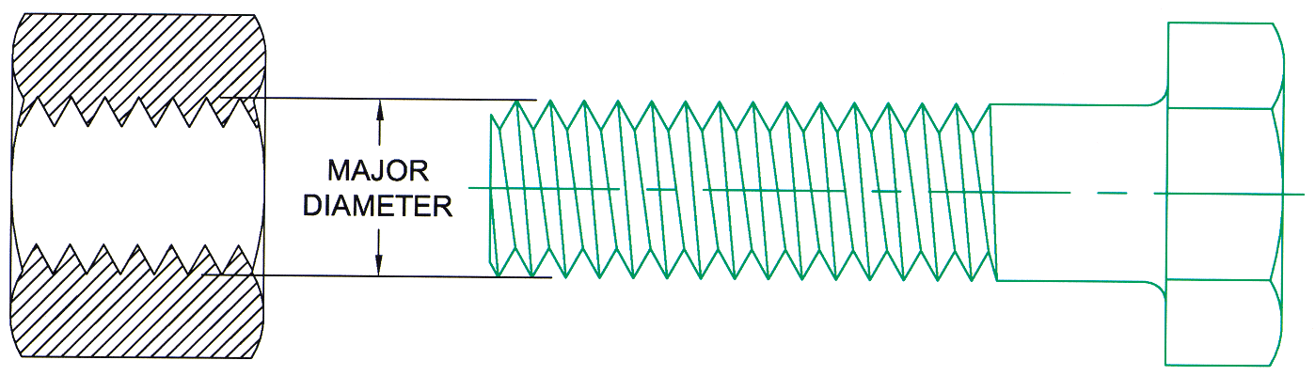
Major Diameter
TAP NOMENCLATURE
Largest diameter on a straight thread

Slide 4
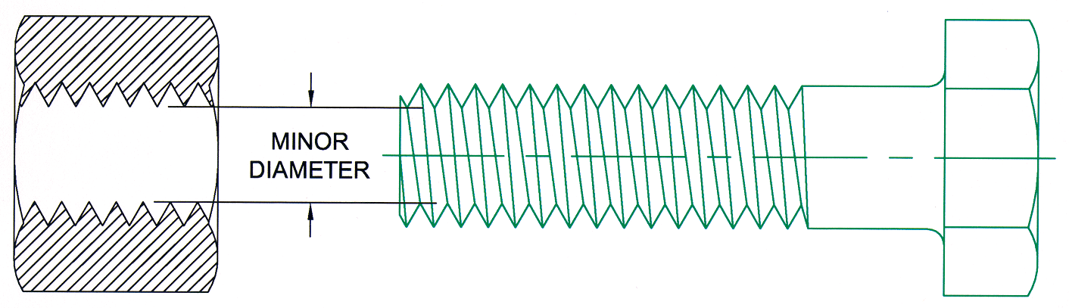
Minor Diameter
TAP NOMENCLATURE
Smallest diameter on a straight thread

Slide 5
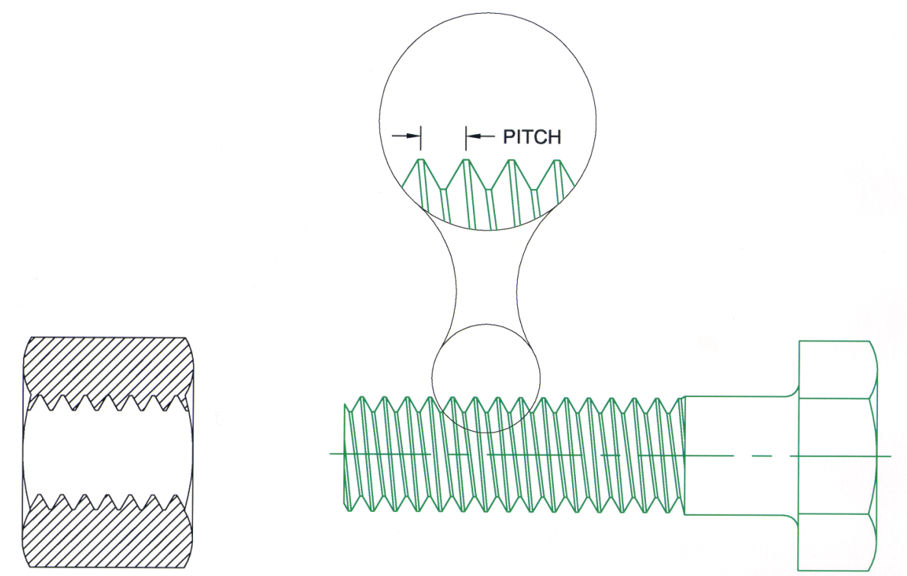
Thread Pitch
TAP NOMENCLATURE
The distance from one point on a thread to the corresponding point on an adjacent thread
Notes:
Imperial Threads: Eg. ¼-20 means 20 threads per inch. To calculate the pitch divide 1 by the threads per inch ( 1/20 = .050” )
Metric Threads: Eg. M6 x 1.0 give you a pitch of 1 mm.

Slide 6
TAP NOMENCLATURE
Flutes
Longitudinal channels which create the cutting edge
Purpose of Flutes
Coolant channel
Chip evacuation
Forms the cutting face
Notes:
Adequate chip room in the flutes to accommodate the swarf is of pivotal consideration when selecting a tap.
If the flutes are too shallow or too narrow chips will not curl properly and more power to form the thread will be required.
Like a drill a tap must cut a chip, accommodate the chip and evacuate the chip.
Smaller taps due to their physical limitations do not permit sufficient flute room to evacuate the chips. It is therefore necessary to narrow the lands and increase the hook in order for the tap to cut more freely.
On taps smaller than5/16” diameter, the use of 4 flutes is not advisable on Unified Coarse Threads (UNC), as there is not sufficient chip room in the flutes, especially in steel.

Slide 7
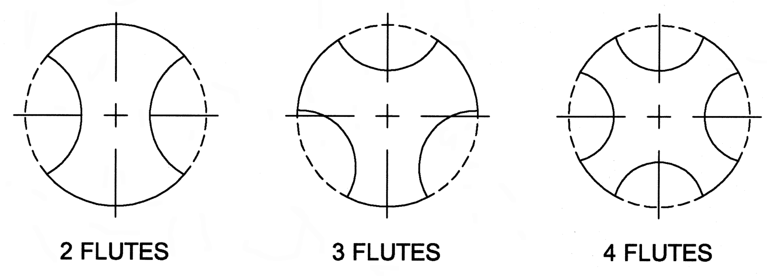
TAP NOMENCLATURE
Number of Flutes
Additional flutes distribute the cutting action over a greater number of teeth
Notes:
The number of flutes of a tap is predicated on the size of tap, the smaller the tap the less number of flutes.
Two flute taps provide more area in the flutes for chip curling.

Slide 8
HOLE TYPE
Tap Selection is based on hole type:
Through Holes
Blind Holes

Slide 9
HAND TAPS
For hand and machine tapping of
through and blind holes
Chamfer Lead
No 1 - Taper
8-9 Threads
No 2 - Plug
3-5 Threads
No 3 - Bottom
2-3 Threads
Tap Wrench

Slide 10
TAPER HAND TAPS
8 - 10 Threads
Taper Lead
Longest chamfer for standard hand taps
Ensures easier starting with less torque
Suitable for tapping difficult to machine materials
Not recommended for blind holes

Slide 11
PLUG HAND TAPS
3 - 5 Threads
Plug Lead
The general purpose tap of the industry
Most commonly used for hand or machine tapping
Suitable for through holes and most blind holes

Slide 12
BOTTOMING HAND TAPS
1 - 2 Threads
Bottoming Lead
Recommended for blind holes
Suitable for threading close to the bottom of a blind hole
Higher torque due to shorter chamfer length
Not recommended for starting new threads

Slide 13
MACHINE TAPPING
Straight
Flute
Spiral
Flute
Spiral
Point
Thread Forming/
Roll Forming
Threadmill

Slide 14
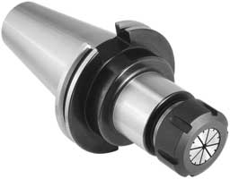
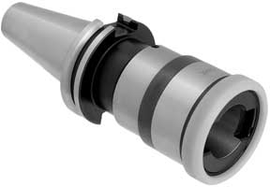
TOOLHOLDING SYSTEMS
Rigid Tap Holders
Collet Chuck
Syncroflex for use on CNC machines with synchronized tapping cycles

Slide 15
SPIRAL POINT TAPS
Recommended for tapping through holes
Push chips ahead rather than store them in the flutes
Notes:
Spiral pointed taps push the chip forward so they are truly recommended for thru holes. They can be used on some blind holes only if there is ample chip space to accommodate the swarf.

Slide 16
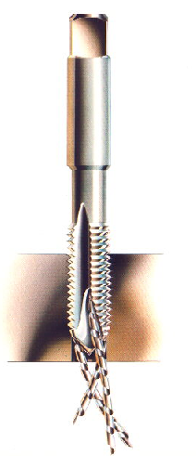
SPIRAL POINT TAPS
The Tapping of Through holes
Chips are pushed forward
Notes:
Add video

Slide 17
SPIRAL FLUTE TAPS
Spiral fluted taps pull the chips out of the hole
Recommended for blind holes and holes which have interruptions due to keyways or grooves
Efficient for tapping depths up to 3 x diameter
Notes:
Spiral fluted taps are intended primarily for blind holes. The helical flute transports the chip away from the cutting edges to avoid chip packing.

Slide 18
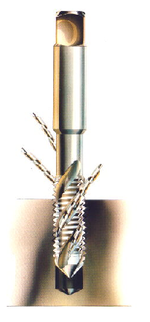
SPIRAL FLUTE TAPS
The Tapping of Blind holes
Taps have different Helix angles
40° - General materials
15° - Tough materials
Chips are pulled
upwards
Notes:
Add video

Slide 19
THREAD FORMING TAPS
Produces Thread By Displacing Material
2 To 3 Times Faster Than Cutting Threads
Stronger Tap Construction
Produces Stronger Thread Form
Much Greater Tap Life
Recommended For Materials Up To 25 Rc

Slide 20
COMMON THREAD TYPES
UNC – Unified Coarse Thread
UNF – Unified Fine Thread
UNEF – Unified Extra Fine Thread
UNS – Unified Special Thread
M – Metric Coarse Thread
MF – Metric Fine Thread

Slide 21
CLASS OF FIT
Unified Threads
Class 1B
Class 2B
Class 3B
Internal
Classes of Fit
Class 1A
Class 2A
Class 3A
External

Slide 22
CLASS OF FIT
1A & 1B
Loose tolerance to permit easy assembly
2A & 2B
Most common for general applications production of bolts, screws and nuts
3A & 3B
Tight tolerance where closeness of fit and/or accuracy of thread elements are important

Slide 23
“H” LIMITS
An “H” number defines the actual pitch diameter of a tap
For each “H” number increase, the actual pitch diameter is increased by .0005” over the basic pitch diameter
H1 = .0000” to .0005
H2 = .0005” to .0010”
H3 = .0010” to .0015”
H4 = .0015” to .0020” (and over)

Slide 24
METRIC SCREW THREADS
Designated by Major Diameter & Pitch
Metric threads start with symbol ‘M’ followed by pitch, separated by symbol ‘x’ (i.e M8 x 1.25)
Metric class of fit:
4H - Tight Tolerance
Similar to Unified 3B Class of Fit
6H - General Purpose
Similar to Unified 2B Class of Fit

Slide 25
Drillco Tap Offering
Hand Taps
Spiral Point
Spiral Flute
Thread Formers
STI
Pulley/Extension
Pipe
Special Thread
Combination Drill/Taps
Tap Wrench
in UNC, UNF, UNS, and Metric

